Slide 1


University of Crete, Heraklion, Greece
Department of Chemistry
Dendrimers
Maria Psarrou 923
Heraklion
29-5-2017

Slide 2
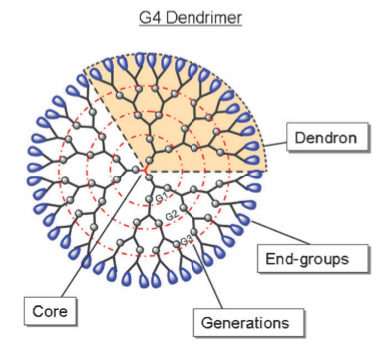
Structure of Dendrimers
Characteristics
Physical and chemical properties
high solubility, miscibility and reactivity
Well defined structures
well defined size, shape,
molecular weight and monodispersity

Slide 3
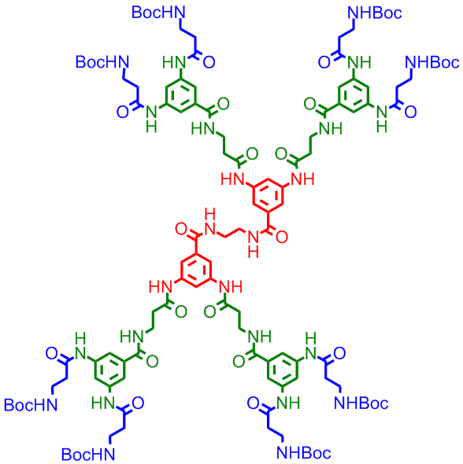
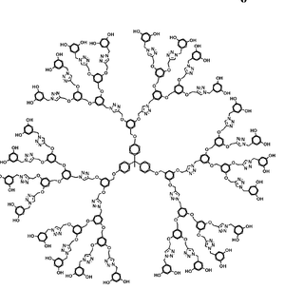
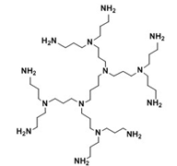
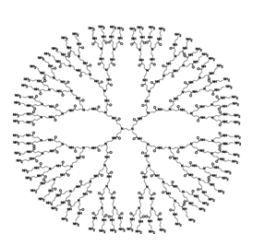
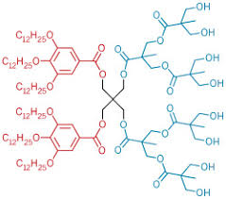
TYPES OF DENDRIMERS
Poly propylamine (PPI)
Peptide
Frechet-type
Amphiphillic
Poly (amidoamino amine) -PAMAM

Slide 4
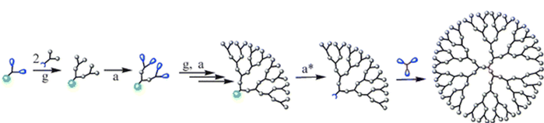
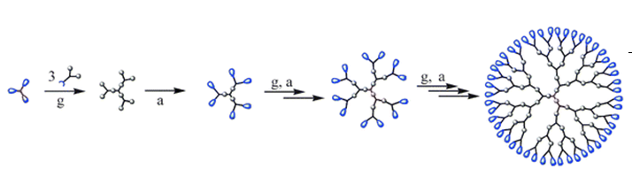
Synthetic Approaches
A) Divergent strategy:
B)Convergent strategy:
a. Activation of surface groups
a*. Activation of core group
g. Dentritic growth
Carlmark A. et al, Chem. Soc. Rev., 38, 352–362, 2009

Slide 5
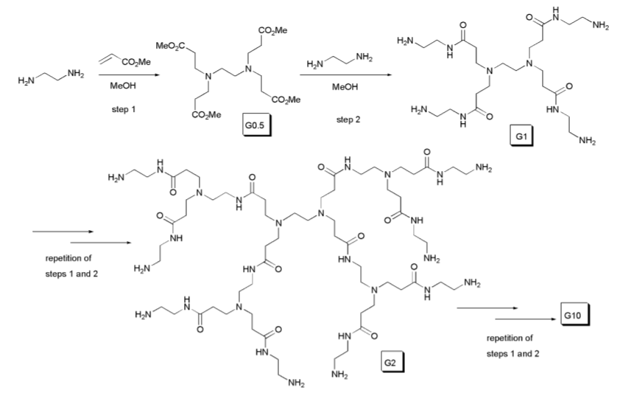
Divergent method
Synthesis of poly(amidoamino amine), PAMAM dendrimer
Two basic reactions:
1) addition of amino groups to methyl acrylate
2)aminolysis of the resulting methyl ester with excess ethylenediamine
Sowinska M. et al, New J.Chem., 2014, 38, 2168

Slide 6
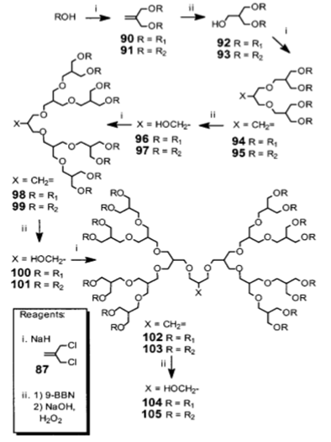
Convergent method
Synthesis of Poly(alkyl ether) dendrimer
This procedure could be repeated in high yields (85%)
Polar backbone similar to poly(ethylene glycol) → wide range of applications
Easy purification
The rugged backbone allowing a wider range of chemical modification
Grayson S. M. and Fre´chet M. J., Chem. Rev. 101, 3819−3867, 2001

Slide 7
Rheological and physicochemical studies
microelectronics
Biomedicine
Surface science
APPLICATIONS
Nano technology
Sensors
Catalyst

Slide 8
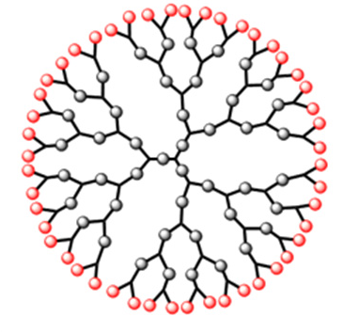
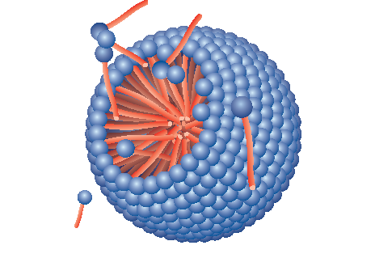
Drug Delivery Applications
Dendrimers versus micelles as nanocarriers
Both structures:
can transfer small molecules(drugs,peptides,gene) with controllable manner
The surface can modified with target molecules
Well-defined structure with high stability due to their synthetic procedure
Encapsulation of small molecules into the cavities (non-covalent bonding)
Bonding of molecules on the surface
Self-assembly structures
Thermodynamically stable
Entrapment of hydrophobic molecules only in the core
Passive diffusion with time

Slide 9
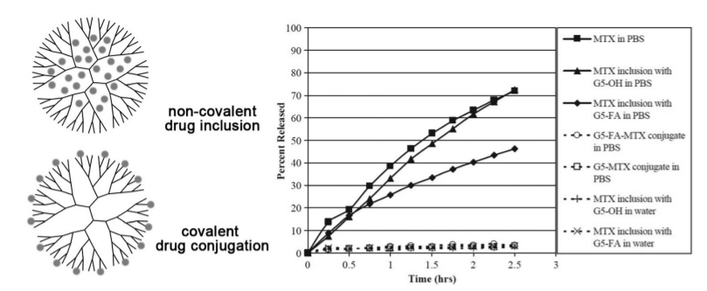
Drug-Dendrimer interaction
Release properties of methotrexate (MTX)
Non-covalent drug inclusion (physical encapsulation):
inter-molecular forces between the small molecules and dendrimers might not be strong enough to withstand the neutralization of a buﬀer salt solution, which results in a burst release.
Covalent drug conjugation:
small molecules are not released regardless of the ion strength of the solution.
Kaminskas L. M. , et al, Mol. Pharm., 9, 355–373, 2012

Slide 10
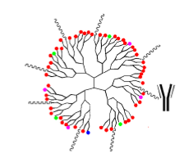
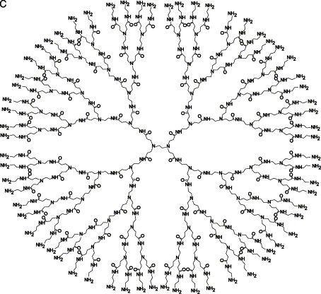
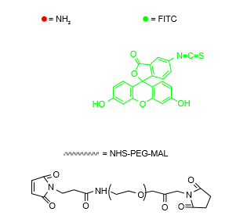
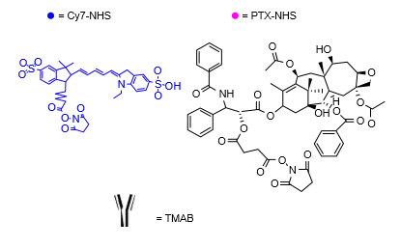
TMAB-PEG-PAMAM-PTX active targeted drug delivery system against breast cancer
Trastuzumab(TMAB)(or Herceptin):
monoclonal antibody that can specifically bind to the human epidermal growth factor receptor 2 (HER2) receptor.
Ma P. et al, Intern. J. Nanomed., 2015:10, 2173–2190

Slide 11
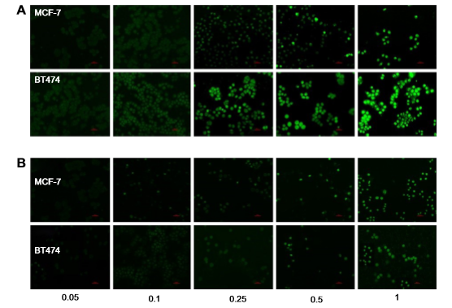
Fluorescence microscopy images of TMAB-PEG-PAMAM-FITC (test)
Fluorescence microscopy images of PEG-PAMAM-FITC (control)
Ma P. et al, Intern. J. Nanomed., 2015:10, 2173–2190

Slide 12
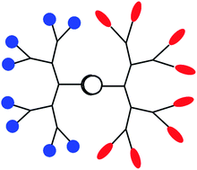
Janus dendrimers
Dendrimers constituted of two dendrimeric wedges and terminated by two diﬀerent functionalities
Characteristics :
Combination of several properties in a single molecule
Binding of different molecules on the two sides
BUT → Difficult synthetic approaches

Slide 13
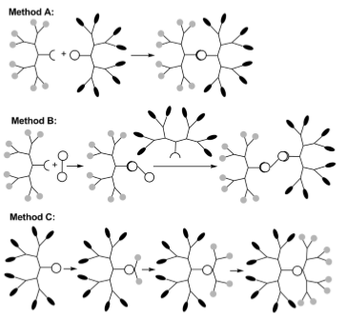
Synthetic methods
Method A: reaction between two dentrons with complementary functions as the core
Method B: reaction of a ﬁrst dendron in a controlled manner with a multifunctional core (at least difunctional), then a second dendron is grafted to the remaining function(s) of the core.
Method C: using the focal point of a dendron for the growing of new branches by a divergent process
Caminade A. M., New J. Chem .,36,217–226, 2012

Slide 14
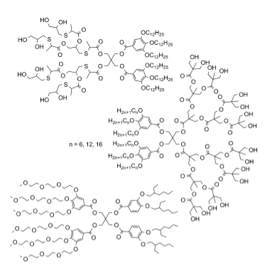
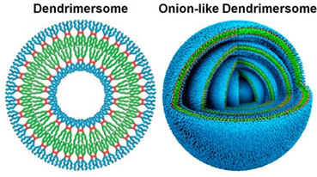
Polyester amphiphilic Janus dendrimers that self-assemble in water
Self-assemply in aqueous solution

Slide 15
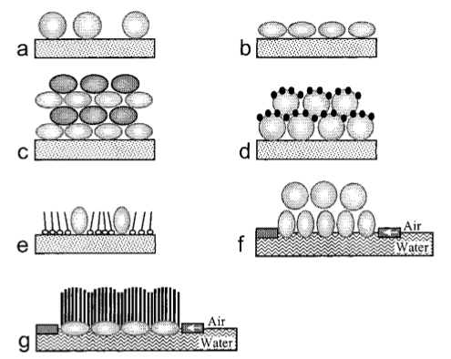
Dendrimers on surfaces
Surface modification with films and coatings of several materials
Properties and characteristics that we can change on a surface:
Hydrophilicity, hydrophobicity,
cell-adhession, antibacterial surfaces, cell-repellent properties

Slide 16
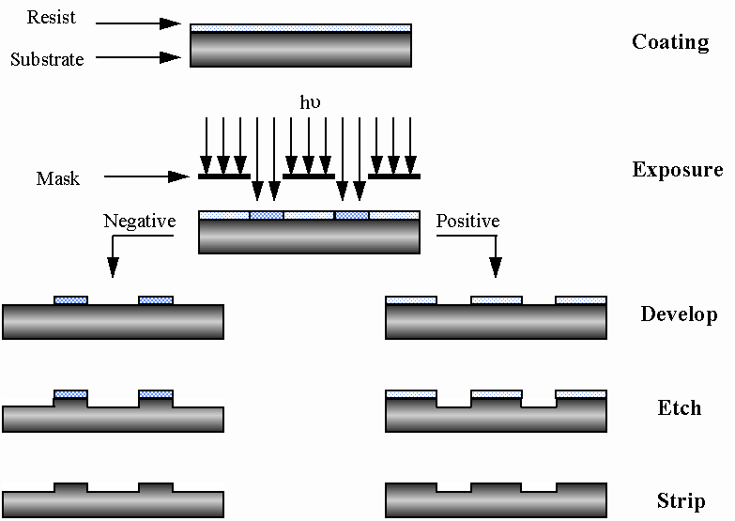
Dendrimers-based resists for lithography
“Next-generation lithography”

Slide 17
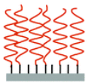
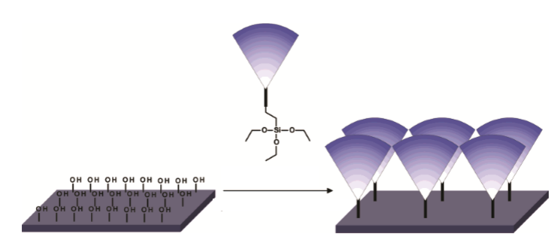
Entaglment of free chains
Highly stable self-assembled monolayer
Dendrimers in the condensed phase display many physical properties that differ significantly from their linear counterparts
We can prevent parameters that have serious impact on resist performance(acid diffusion, dissolution rates, line-edge roughness)
Ronaldi M. et al, Nano Lett., 4,889-893, 2004

Slide 18
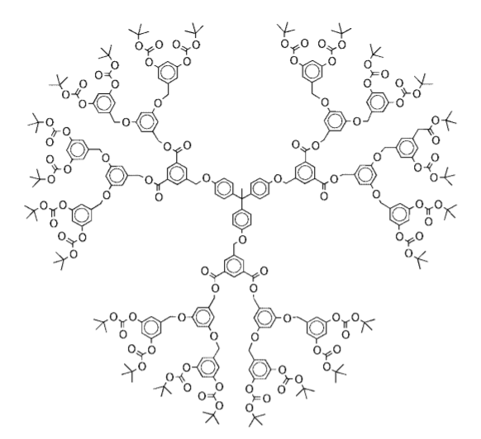
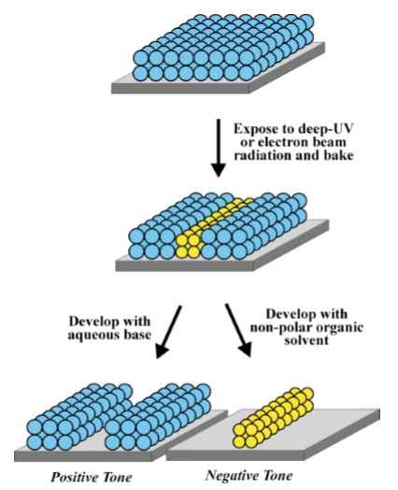
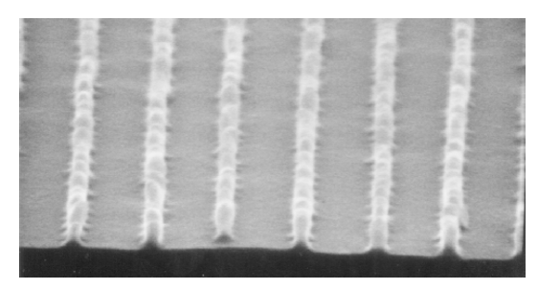
Poly(benzyl ether) dendrimers with Boc or tert-butyl ester groups at their periphery were synthesized via a modification of the convergent route,[G-3] dendrimer
Tully D. C. et al, Chem. Commun., 1229–1239, 2001
SEM of negative tone images generated in Boc dendrimer resist. Linewidths: 50 nm, line heights: 100 nm

